Slide 1

Chicago Hope in Context
A unique position in a complicated educational landscape

Slide 2
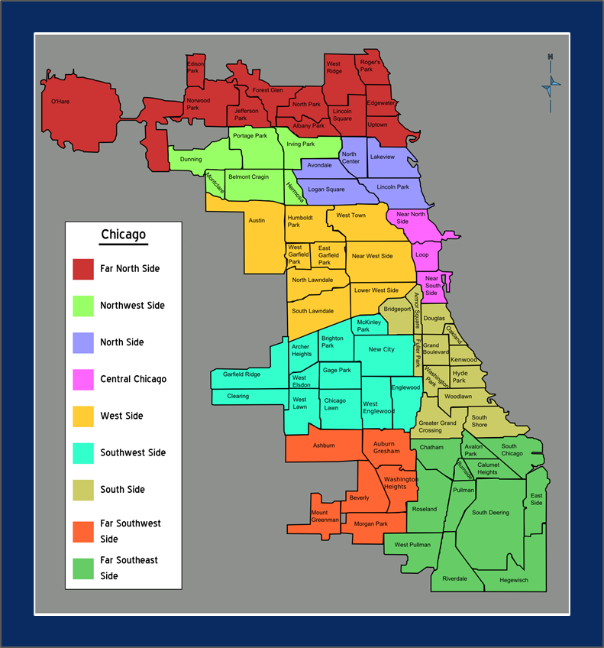
Chicago Public Schools
Enrollment:
430,000 (2000)
403,000 (2013)
380,000 (2014)
322,106 (2022)
Currently 160 high schools with 104,000 students enrolled

Slide 3
Charter Schools
Year | CPS Numbers | Charter Numbers
2000 | 430,000 | Launch in 2005
2006 | 426,000 | 16,642
2008 | 407,955 | 24,476
2013 | 403,000 | 53,564
2014 | 380,000 | 59,422
2017 | 371,382 | 62,435
2022 | 322,106 | 54,375
Of the 322,106 CPS Students, 54,375 are in Charters (16%)
Traditional Public Schools:
415 Elementary
83 High School
Charter Schools:
53 Elementary
40 High school
18 Options Charter Schools
Overall enrollment drops while charter numbers increase – leaving high numbers of empty seats in public schools (38%)
Notes:
https://www.cps.edu/globalassets/cps-pages/about-cps/finance/annual-financial-report/cps_2009_pafr_jan_19.pdf
https://projects.iq.harvard.edu/files/pelp/files/pel033p2.pdf
https://www.incschools.org/get-the-facts/

Slide 4
Charter Schools Closing Too
Urban Prep Charter School Network lost their charter (Article Link) in November 2022. Urban Prep Fading Away (Article Link). They’ve struggled with Financial Mismanagement (Article Link)
 | Englewood Campus | West Campus | Bronzeville Campus
Inaugural Year | 2006 | 2009 | 2010
Enrollment 2015 | 477 | No data. | 479
Enrollment 2019 | 260 | 94 | 340
Enrollment 2022 | 148 | No Longer Listed | 215
Jane Adams Charter School - the Network shut down this school year (2022)
Young Women’s Leadership Charter School closed in 2019. Link

Slide 5

Chicago Public Schools
Racial Breakdown:
10% - White
47% - Hispanic
36% - Black
4% - Asian
(four other categories for last 3%)

Slide 6
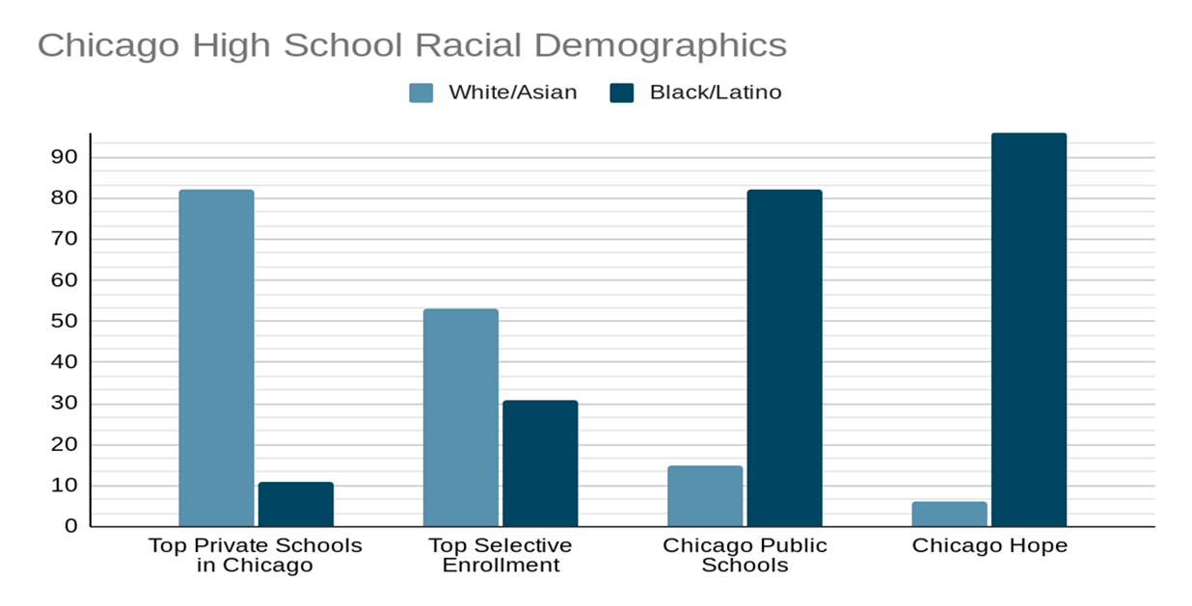
Racial demographics by “type” of school

Slide 7

Chicago Private School Tuition Amounts
Francis Parker: 75% pay $40,000 full tuition
UChicago Lab: 30% pay $40,000 full tuition
Latin: 88% pay $40,000 full tuition
St. Ignatius: 72% pay $20,000 full tuition.
GCE: $4,500 - $29,000. $15,000 is the average payment.
Waldorf: $6,360 - $31,800
Morgan Park Academy: $12,500 (minimum). Average $20,000
Average Chicago Hope Tuition Amount: $2,400.
There are very few affordable private schools remaining in Chicago.
Consider the books “quality academic opportunities”

Slide 8
Chicago Private School Closings in CHA’s lifetime:
Chicago Hope Academy is one of the only non-Catholic, Christian High School in Chicago
Holy Cross (2004)
Immaculate Heart of Mary (2005)
Quigley High School (2007)
Maria High School (2013)
Mount Assisi (2014) Link
Luther South (2014)Link
Seton Academy (2016) Link
Mother of Mercy (2017) Link
Hales Franciscan (2017) Link
Luther North (2017) Link
Queen of Peace (2017) Link
St. Benedict (2019) Link
Guerin Prep (2020) Link
St. Joseph (2021) LinkTuition increases (nuns and priests ain’t workin for free no more)
17 Catholic High Schools remain in Chicago. 29 in the Chicagoland area.
Of the 17 in Chicago, the following 7 have been dropping in enrollment.
  Leo High School
  Holy Trinity
  Our Lady of Tepeyac
  Josephinum Academy
  St Francis de Sales
  St. Patrick
  Resurrection
In addition to several schools above, Cristo Rey and Christ the King are other Chicago high schools serving a predominantly low income, first generation population.

Slide 9
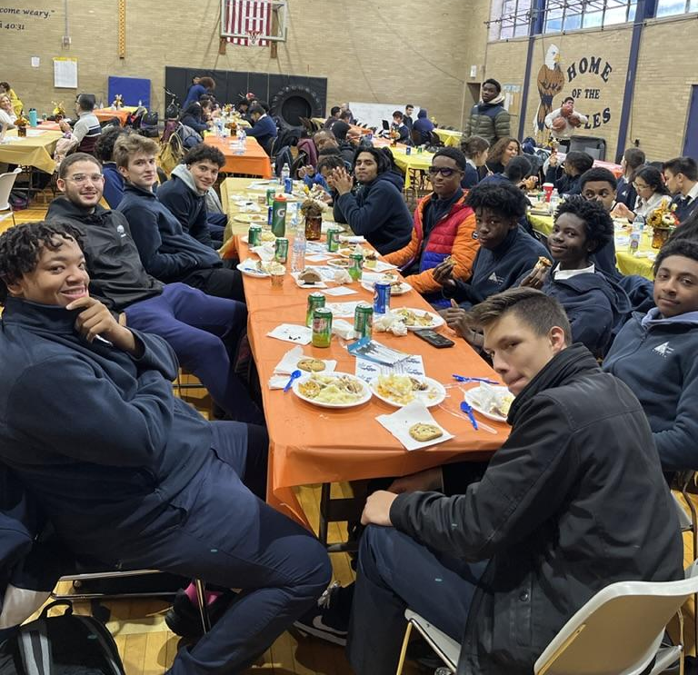
Chicago Hope Academy Family Demographics
290 Students (At capacity with a waitlist)
48% Black
48% Latino
4% White/Asian
60 - 75% first generation college students
80-90% come from CPS/Charter Schools
Average Hope tuition: $2,400
Majority qualify for Invest in Kids Tax Credit Scholarship

Slide 10
What is the Invest in Kids Tax Credit Scholarship?
It is a 75% tax credit for a donation to a private school in Illinois.
Must be for a student whose family would be unlikely to afford a private school
John Doe gives $10,000 to Hope → John receives a $7,500 tax credit
Aaron X (Hope Student)
  Aaron receives $10,000 in Invest in Kids “scholarship” to attend Hope.
  Aaron’s family pays $2,400 out of pocket (everyone pays something)
  Aaron receives $4,000 in additional financial aid from Hope’s other funding sources
    EG: An incredible bike ride across the country.

Slide 11


School Profile: Manley
Student Profile: Treville
Why would a student pursue Hope?
Capacity: 1,200
Enrollment: ___
Manley is spending ~ $40,000 per student (Link).
Extracurriculars
Hope 2020
U Chicago 2024
Treville Hilton's Story
  Two sets of Twins
  Menards and Enrollment Fees
Documentary Trailer Link

Slide 12
Why would a student pursue Hope?
Many neighborhoods and Public Schools options are tough:
Halloween Shooting at a Vigil, 2022
Harper High
  In the 2012, 29 students were shot. 8 were killed (Harper High School). (Link). Transcript Link.
  In 2007, the school had 1,100 fights during the school year. Arne Duncan helped with Harper's "turnaround" effort. This article helps shed light on how DIFFICULT turning around a tough school can be.
  A tale of two cities: : Oprah's 2006 video of Nequa Valley (Naperville) vs. Harper High (Chicago) Realities
    Fifteen years later (2021), 19 seniors graduated from Harper High, then the school closed. Permanently.

Slide 13
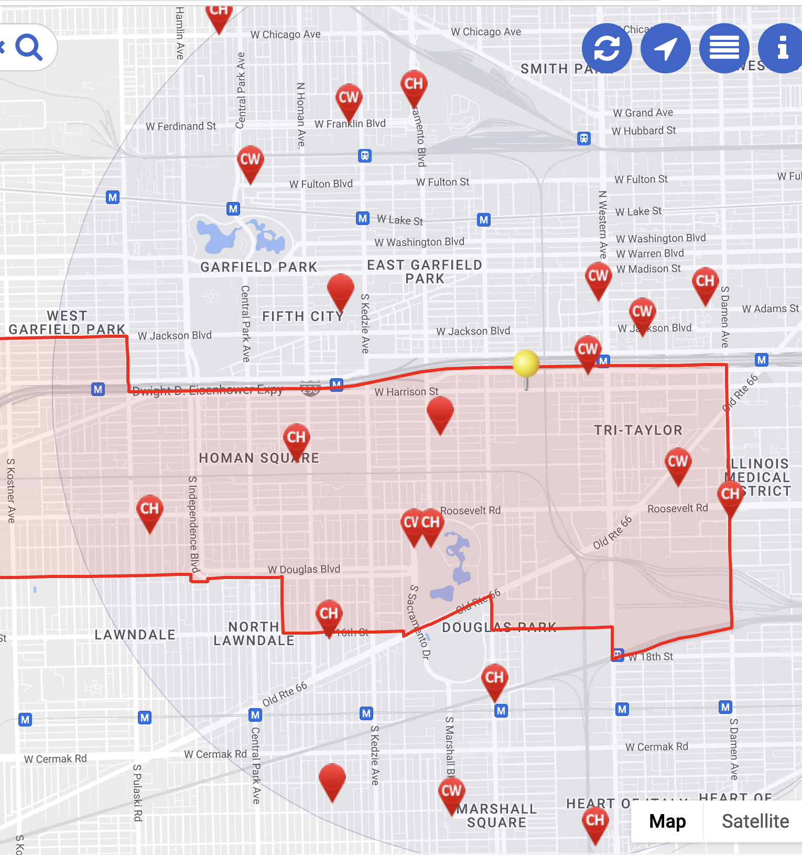

Local CPS Enrollment Numbers
7
 | School | 2015 | 2022
1 | Manley | 356 | 75
2 | Noble DRW | 463 | 340
3 | Collins | 419 | 214
4 | North Lawndale - Christiana | 411 | 314
5 | Marshall | 514 | 193
6 | Al Raby | 488 | 173
7 | Rowe Clark | 624 | 371
8 | Spry | 186 | 76
9 | Farragut | 987 | 455
10 | Instituto Health | 769 | 618
#
CHA West Campus
6
5
Hope
#
1
2
#
#
3
4
#
9
8
10
# indicates “Options” School (Alternative Education)

Slide 14
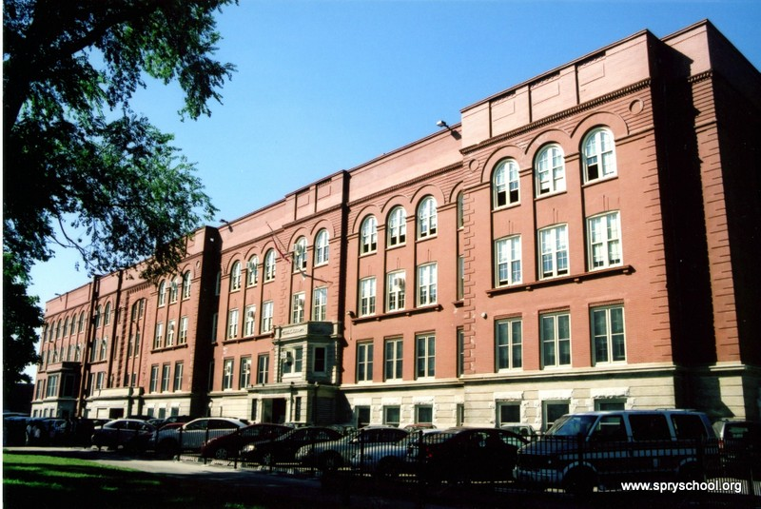
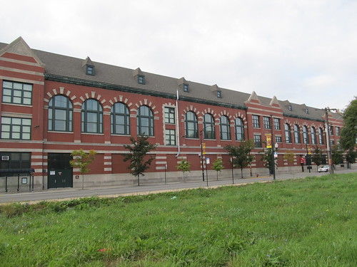
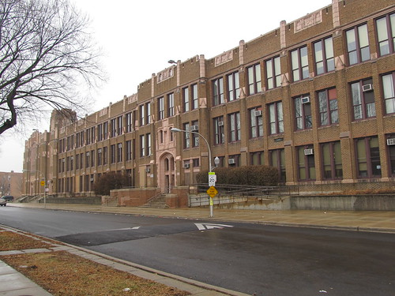
Spry High School. 76 Students.
Marshall High School. 193 Students
Underutilized CPS School Buildings.
These buildings are huge.
Manley High School. 75 Students

Slide 15
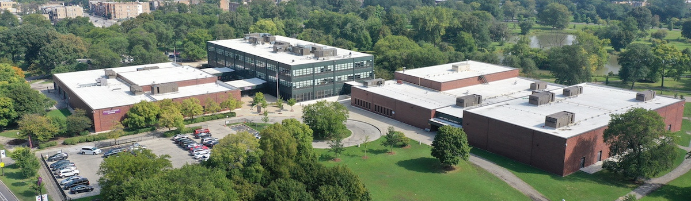
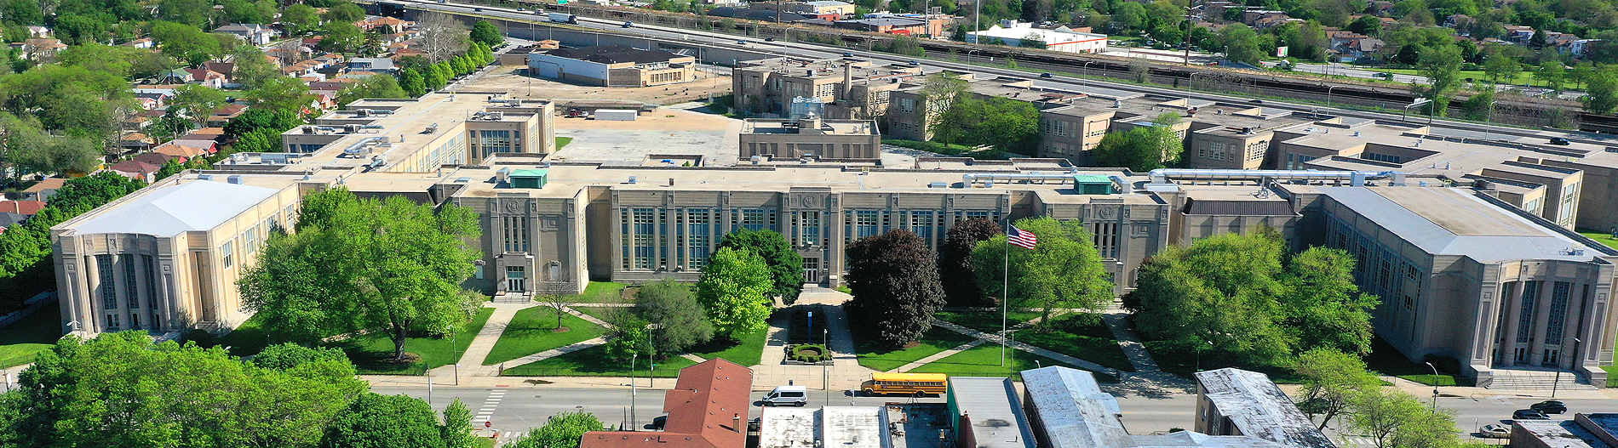
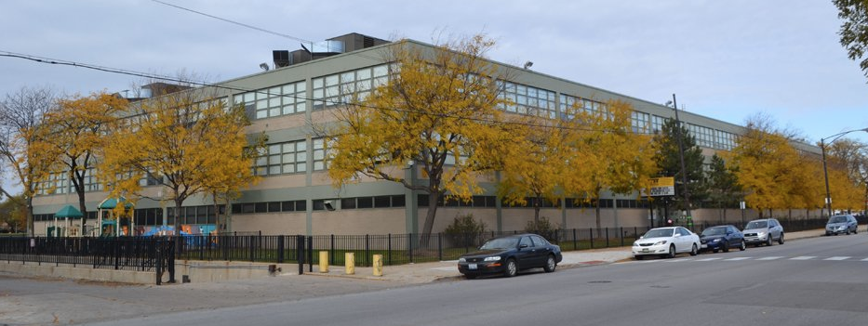
Underutilized CPS School Buildings.
These buildings are huge.
Collins High School. 214 Students (419 in 2015)
Chicago Vocational. 644 Students (953 in 2015)
Many of these buildings have underutilized/extra gymnasiums. Collins has an empty swimming pool. Collins and Orr should receive grants/funding for CTE courses. It would be practical.
Orr: ACT percentile: 12th. Percentage of students attempting to enroll in college: 28%
Collins: ACT: 12th percentile. College enrollment attempt: 63%. Collegiate persistence data unknown.
Orr High School. 235 Students (458 in 2015)

Slide 16
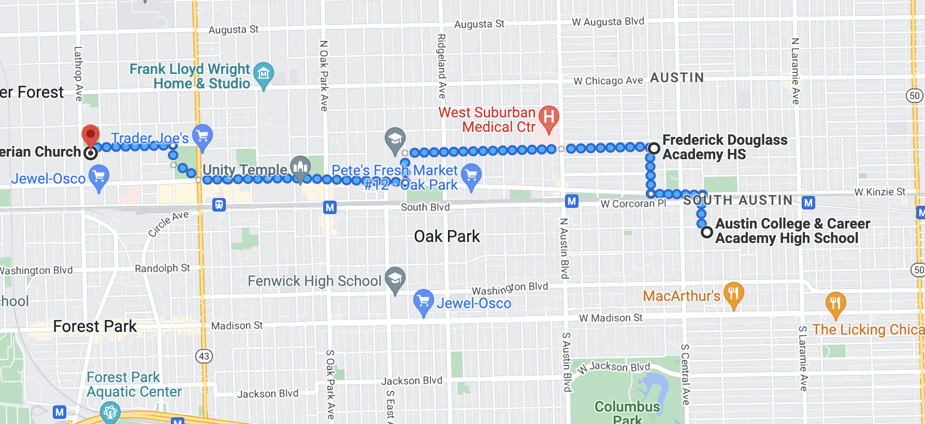

Two Schools Near Oak Park
 | Under-enrolled Schools | 2015 | 2022 | Student Loss | Staff Count
1 | Douglass | 243 | 34 | 86% | 21
2 | Austin | 254 | 182 | 28% | 43
3 | Uplift Community | 326 | 97 | 70% | 49

Slide 17
Budgets continue to increase for CPS, but some schools CAN’T Close
CPS Year 2003:
Budget: $4.6 Billion
430,000
Spending per student: $10,697
CPS 2023
Budget: $9.4 Billion
Students 322,000
Spending per student: $29,192
***A Charter School gets about $13,500 per high school student
In 2013, Mayor Rahm Emanuel closed 50 under-enrolled schools. Received huge backlash.
Relevant Read: Eve Ewing’s Ghosts in the Schoolyard
  Finance/Economics vs. Social obligations to a community
State law prohibits school closings in Chicago until 2025 (Link)
Which schools will close?

Slide 18
“Options” Schools Have Been Replacing Under-enrolled Schools
“Many students say they came to the alternative school after finding their first school chaotic, marked by a lot of fights and not enough caring staff. They say they love Progressive (an Options school) because of the support shown by the staff.
But they can quickly list the things they wish the school had — from hot lunches to extracurricular activities, to a way to provide cash assistance to families in emergencies.
Assistant Principal Carol Robinson said she dreams of having a bigger space for her students. The school is in a church and doesn’t have room for some of the programs she wants for her 200 students, like after-school programs and a broader array of electives.”
“Options” are “Alternative” schools
Currently, 10% of CPS high school students attend an alternative school.
39 Schools serving 11,000 students
39% of students who enroll will graduate
University of Chicago Education Lab Report (Link)
Most of the Options schools are run by private providers. They were paid about $47 million last school year.
What are the 61% non-graduates doing?

Slide 19
More than a school, Hope is a movement.
Strong Community
Connections to churches
Mentorship Partnerships (Together Chicago)
Intramural sports options within our dynamite athletics facilities on the West Campus
Career Advancement Center
Potential Partnerships
CRED (Arne Duncan)
Hope Chicago (Janice Jackson)
New Life Centers
UCAN
Churches citywide
ChiCAT
Illinois Medical District
City Colleges of Chicago
Cara Collective
Greater West Town Project
Hope’s Career and Technical Education Center will be a beacon on a hill, increasing enrollment by 200 while also educating hundreds of non-Hope students and adults.
Non-Hope student facility usage
3:30pm - 8:00pm Monday - Friday
8am - 7pm Saturdays
8am - 7pm in the summer months.
If Options school students are working during the day, they can attend classes in late afternoon and/or evening hours
Adults in continuing education programs and can partner with other vocational schools (private or public) to use our space as well.
  The majority of the Options Schools are privately run. Hope Afternoon/Evening Trade School will be a fantastic option for students.

Slide 20
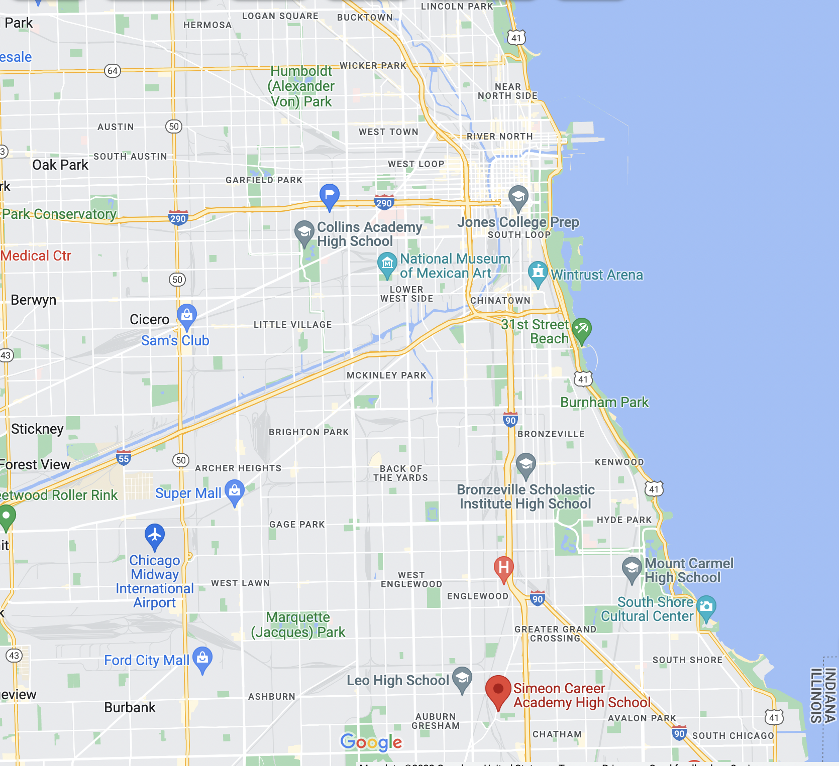





Vocational High Schools
No CTE High School Availability on Near West Side of Chicago
Year | Dunbar | CVS | Simeon | Prosser
2022 | 446 | 644 | 1,139 | 1,149
2019 | 320 | 894 | 1,345 | 1,329
2015 | 1,034 | 953 | 1,402 | 1,476
Chicago Hope Academy
Prosser
Dunbar
Simeon
Chicago Vocational
Chicago’s Most Dangerous Neighborhoods List (2022)
#1: West Garfield Park
#3: East Garfield Park
#5: North Lawndale

Slide 21
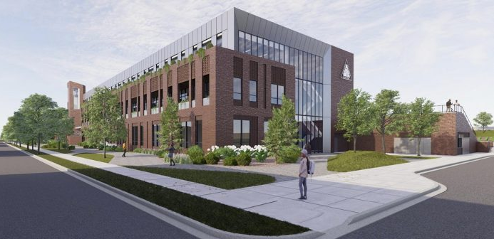
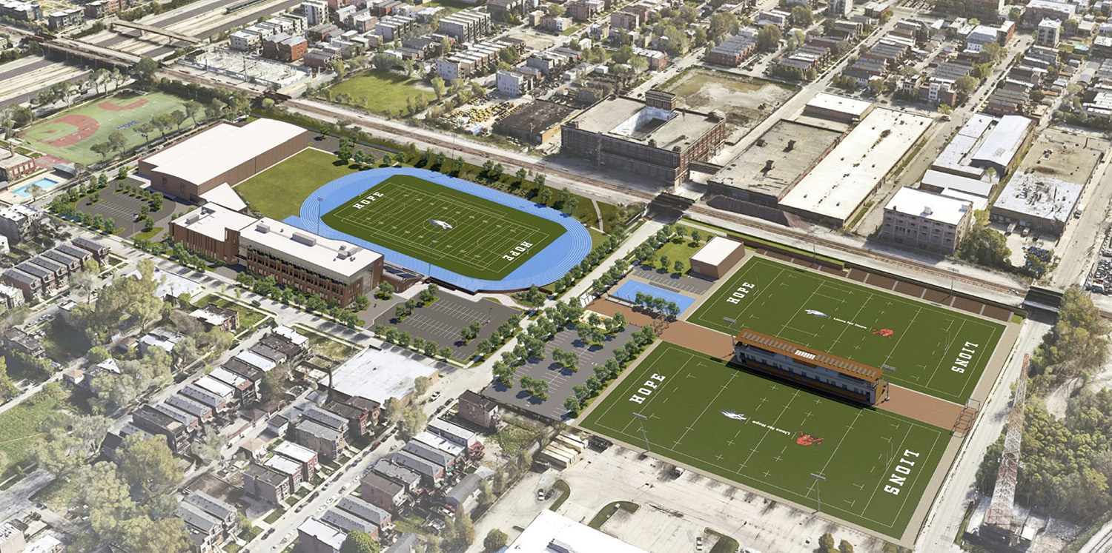

Chicago Hope’s Proposed Building
Watch this Animation of our Proposed Building (Video Link)
This would be adjusted to include large CTE classrooms
New Building Site.

Slide 22
Chicago Builds Program at Dunbar High School. Low levels of participation.
Chicago Builds Brochure
Chicago Builds 1 Pager
“Chicago Builds Construction Campus at Dunbar is the city's first comprehensive citywide trades program. 11th and 12th grade CPS students travel to Chicago Builds for the second part of their regular school day to receive in-depth exposure to the construction industry and gain skills necessary for a career in construction.”
Dunbar has a fully staffed CTE program and the facilities are dynamite.
Avg. SAT Score | 5 Year Grad Rate | College Enrollment | College Persistence | Of the 446 Enrolled
12th Percentile | 65% | 59% | 46% | 78 will complete 1 year of college (17%)
I was told 130 students should be involved in the program, but only 80 enrolled this past year.
Program offered to bus students in - didn’t work. After hour usage? Not happening.
If Hope had Dunbar’s facilities, 75% of students would be required to take technical courses. Even if students intend to study 18th century French Poetry in college.

Slide 23
Is college for everyone? No.
Hope Chicago Five School Profiles
Hope Chicago Scholarship: *The most popular scholarship in Chicago news in the summer of 2022.
Social experiment/investment to see if the elimination of financial barriers will put AND KEEP students in college.
I hope all students in the program go on and graduate college, but I think a focus on intervention should be placed elsewhere.
 | Juarez | Johnson (Noble) | Al Raby | Morgan Park | Farragut
2022 Enrollment | 1,590 | 470 | 173 | 1,072 | 455
2015 Enrollment | 1,676 | 848 | 488 | 1,436 | 987
Average SAT Score | 862 | 802 | 777 | 822 | 777
SAT National Percentile | 19th | 12th | 9th | 15th | 9th
Chronic Truancy | 61% | 79% | 89% | 51% | 89%
College Enrollment | 57% | 62% | 55% | 59% | 55%
Performance Data | Inability to rate | Inability to rate | Inability to rate | Inability to rate | Inability to rate
The reality: For high school seniors who read at a 5th grade level, write on a 5th grade level, and haven’t demonstrated mastery of basic skills in Geometry and Algebra 1…college MIGHT be the answer. A student could make it happen. True.
With that being said…should students testing in the 12th percentile (in 11th grade) be exposed and encouraged to pursue trade and technical education options sooner? My answer to that question is, yes. Not forcing them into the trades, but extensively exposing them to relevant classwork in those careers (sooner) is a solid idea.

Slide 24
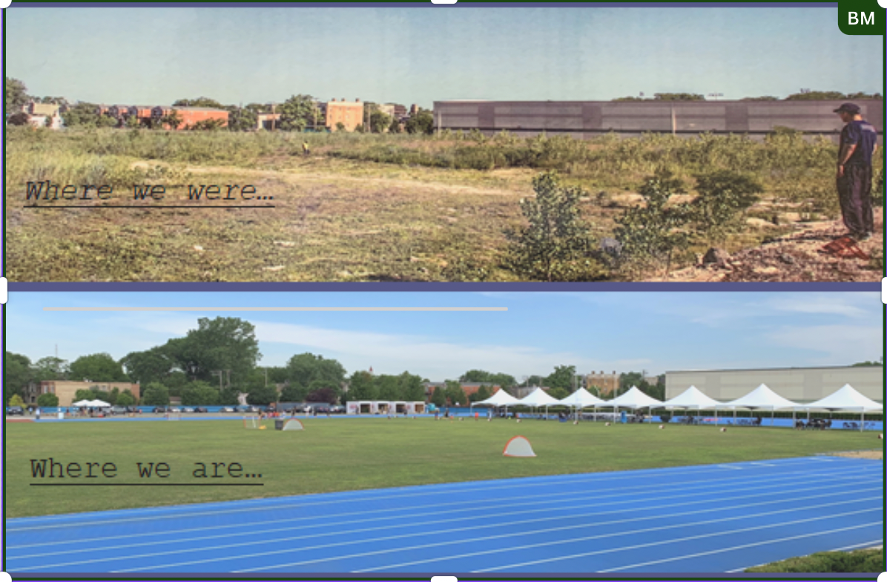
Hope’s Story Line
Before and After: Bob Muzikowski (far right) looking over a vacant lot in 2017
1994-2003: Living Light Ministries (Link).
1991-1999: Near North Little League in Cabrini Green
1995- Present: Near West Little League -- Inspiration for the Movie Hardball.
2005: Chicago Hope Academy launches with 60 freshmen.
2017: Builds out Track and West Campus Facilities Recreational Activities Video
2019: Rugby Field built in partnership with Chicago Lions
2020: Acquire Quest Athletic Center. Facility Video (Link)

Slide 25
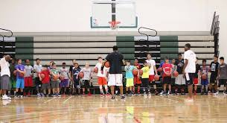
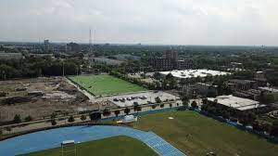
Attracting Partnerships to our West Campus
Over 5,000 athletes use our facilities each year
Special Olympics Chicago
  Volunteers of the Year Award (Video Link)
Chicago Lions Rugby Club
Jordan Brand Classic, Tracy McGrady Tournaments,
Genesis Orthopedics
Revolution Therapy
Altus Middle School
Near West Little League
Latin High School, LEARN Charter School Network, Hi Five Sports Camp
Hosted the 28th Ward’s Senior Citizen Luncheon for hundreds of seniors from East Garfield Park
Chicago ELITE Volleyball. 200 girls from the suburbs 3 nights per week
Chicago Police Department Youth Outreach Open Gyms
Sectional track meets for over 1,000 athletes

Slide 26
CHA’s applicant pool is not cherry picked
Hope’s 8th grade applicants take the High School Placement Test. National Percentile scores for our applicants in 2022:
Median: 13th percentile
Mean: 18th percentile
We offer a college prep curriculum, but the reality is that many of our applicants are not prepared for it.
We focus on:
Building a strong school culture of unity and inclusion to create a sense of belonging
Connecting students with mentors and role models
Celebrating students for pursuing a passion as we encourage them to pursue extracurricular activities
Kindness, peace, and forgiveness
We have students who will pursue Ivy League schools and students who will pursue a career in the trades. We are outcome agnostic…but we want to offer trades courses.

Slide 27
Hope Train Rolls On
It costs approximately $16,500 to fund each Hope student. On average, the families cover $2,500. The $14,000 shortfall for 300 students is much easier to raise when there is a tax credit incentive for our donor base in Illinois.
Catholic schools serving low-income families are closing left and right because private funding is difficult (nuns and priests are no longer working for free). The private, religious school experience is now becoming restricted to the upper class
Our local schools are dropping in enrollment not because of Hope, but because of the low quality of the educational experience. These schools are not attracting students. If we launched a Trade School on the West Campus – more students could attend, and after school and evening programming could bless hundreds of West Side Chicagoans with an education and skill empowerment experience.
Hope is not the perfect school, but we have become a school that the city of Chicago should be protecting and promoting.
Invest in Kids Tax Credit Scholarships fund about ⅓ or the Hope budget
The Chicago Teachers Union Aggressively Opposes the Program
CTU Documentary
Pritzker Expressed he no longer Opposes the Bill
Chicago Hope Protests in Springfield to Save Our Scholarships

